Slide 1
Name: Ashfaq Ahmad Department: CSE Section: B Reg no: 19pwcse1795
Communication and presentation skills

Slide 2
Introduction to c++

Slide 3
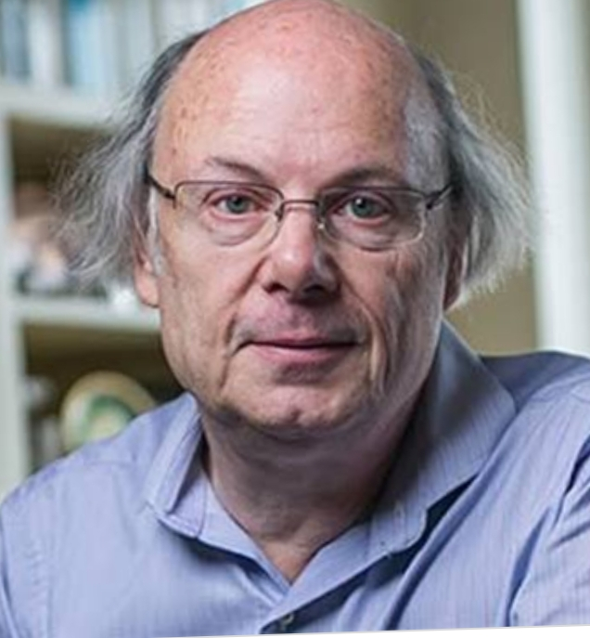
Introduction
Developed in 1979 at bell labs.
By stroustrup.
Combination of simula and C.
Initially called “C with classes”.
Released in1985 as C++.
Middle level language.

Slide 4
General purpose programming language.
For example
Object oriented programming
Procedural programming
Functional programming
Generic programming

Slide 5
compiler
Program to convert source code to machine code.
Allow code to execute.
Check source code for correctness.
Each programming language has own compiler.

Slide 6
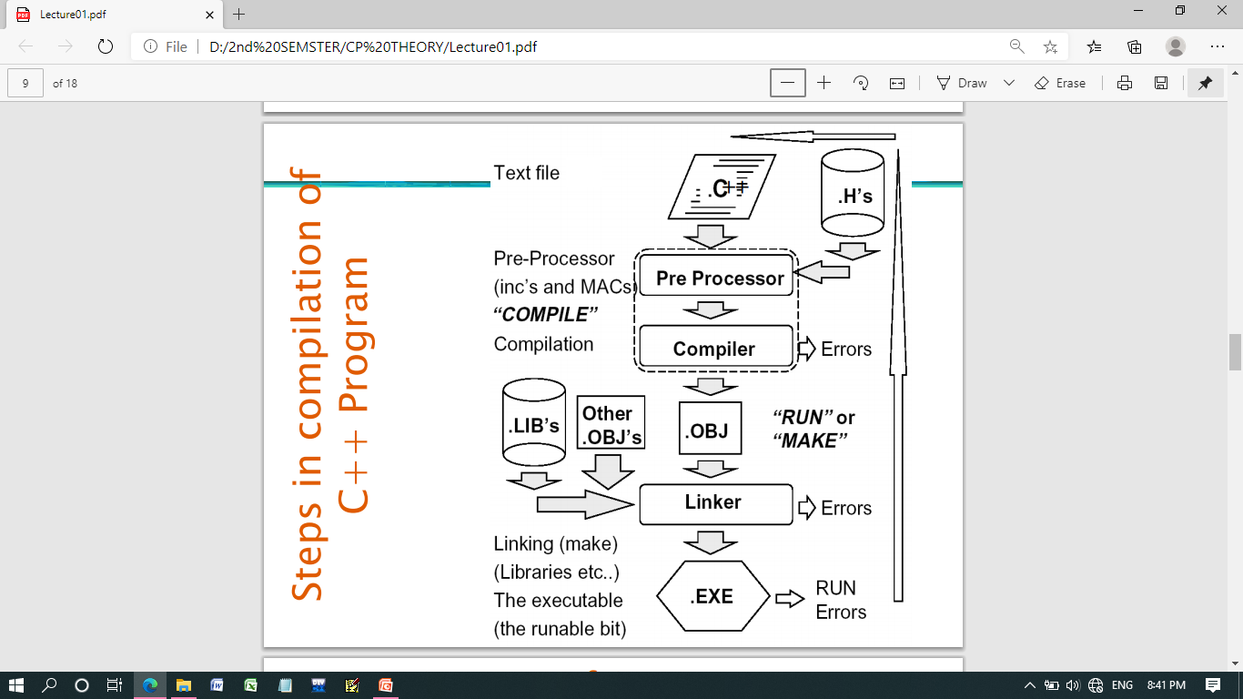
Steps of compilation in C++ program

Slide 7
Version of C++
C++98
C++03
C++TR1
C++11

Slide 8
Parts of C++ program
C++ program consists of three main parts;
Preprocessor Directives.
Start with “#” .
The main( ) function.
C++ statements

Slide 9
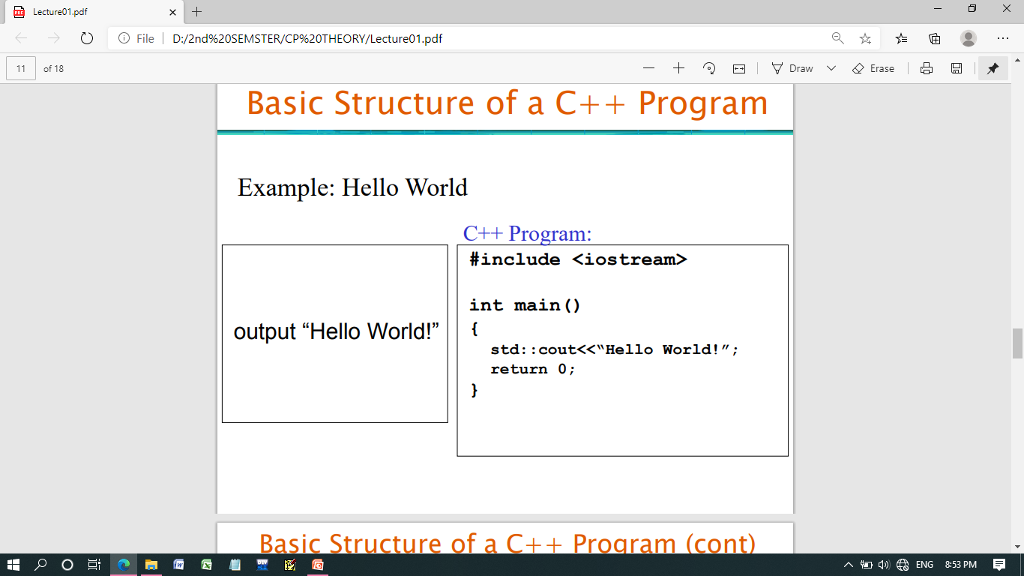
Example

Slide 10
Uses of C++
Computer games
Utilities
Operating system
compiler

Slide 11
Application of C++
MS office
Adobe Photoshop
Adobe illustrator
Mozilla Firefox
Window NT/98/XP/7/8 etc.

Slide 12
Some Google files
Google file system
Google chromium

Slide 13
Thanks you

